Slide 1
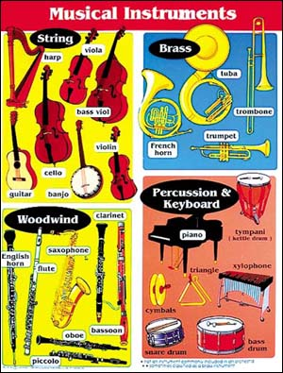

Slide 2
The conductor wants you to
name the instruments.

Slide 3
Name the instrument
Guitar
Violin

Slide 4
You Are Right

Slide 5
Sorry

Slide 6
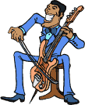
Name the instrument
Cello
Bass

Slide 7
You Are Right

Slide 8
Sorry

Slide 9
Name the instrument
Bass
Violin

Slide 10
You Are Right

Slide 11
Sorry

Slide 12
Name the instrument
Flute
Trombone

Slide 13
You Are Right

Slide 14
Sorry

Slide 15
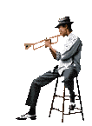
Name the instrument
Trumpet
Trombone

Slide 16
You Are Right

Slide 17
Sorry

Slide 18
Name the instrument
Cello
Guitar

Slide 19
You Are Right

Slide 20
Sorry

Slide 21
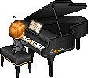
Name the instrument
Grand Piano
Electric
Piano

Slide 22
You Are Right

Slide 23
Sorry

Slide 24
Name the instrument
Saxophone
Trumpet

Slide 25
You Are Right

Slide 26
Sorry

Slide 27
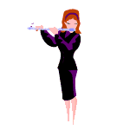
Name the instrument
Flute
Trombone

Slide 28
You Are Right

Slide 29
Sorry

Slide 30
Name the instrument
Cymbals
Snare Drum

Slide 31
You Are Right

Slide 32
Sorry

Slide 33
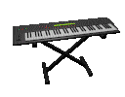
Name the instrument
Grand Piano
Electric Piano

Slide 34
You Are Right

Slide 35
Sorry

Slide 36
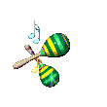
Name the instrument
Cymbals
Maracas

Slide 37
You Are Right

Slide 38
Sorry

Slide 39
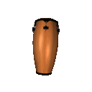
Name the instrument
Conga Drum
Bass Drum

Slide 40
You Are Right

Slide 41
Sorry

Slide 42
Name the instrument
Violin
Cello

Slide 43
You Are Right

Slide 44
Sorry

Slide 45
Name the instrument
Bass Drum
Guitar

Slide 46
You Are Right

Slide 47
Sorry

Slide 48
Name the instrument
Trombone
Bass

Slide 49
You Are Right

Slide 50
Sorry

Slide 51
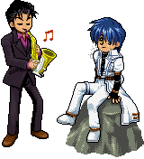
Name the instrument
Saxophone
Trombone

Slide 52
You Are Right

Slide 53
Sorry

Slide 54
Name the instrument
Trumpet
Trombone

Slide 55
You Are Right

Slide 56
Sorry

Slide 57
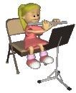
Name the instrument
Harp
Flute

Slide 58
You Are Right

Slide 59
Sorry

Slide 60
Name the instrument
Trumpet
Trombone

Slide 61
You Are Right

Slide 62
Sorry

Slide 63
Name the instrument
Snare Drum
Conga Drum

Slide 64
You Are Right

Slide 65
Sorry

Slide 66
Name the instrument
Drum set
Snare Drum

Slide 67
You Are Right

Slide 68
Sorry

Slide 69
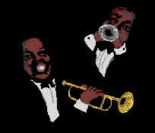
Name the instrument
Trumpet
Trombone

Slide 70
You Are Right

Slide 71
Sorry

Slide 72
Name the instrument
Bass Drum
Snare Drum

Slide 73
You Are Right

Slide 74
Sorry

Slide 75
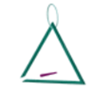
Name the instrument
Triangle
Bell

Slide 76
You Are Right

Slide 77
Sorry

Slide 78
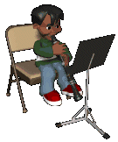
Name the instrument
Clarinet
Flute

Slide 79
You Are Right

Slide 80
Sorry

Slide 81
Grand Piano
Upright
Piano

Slide 82
You Are Right

Slide 83
Sorry

Slide 84
Great Job Wildcat Music Kids !

